Slide 1
Lending Club case study
Vishnu sagar thupili
Rishi Panchal

Slide 2
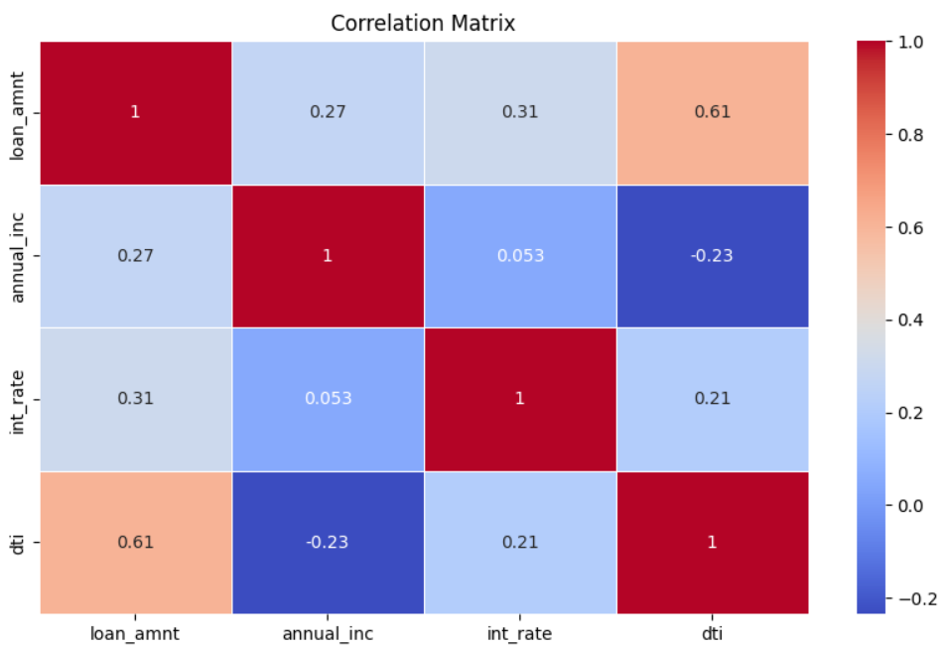
Correlation Matrix (numerical – Numerical Analysis)
Numerical data comparison between (annual income, loan amount, interest rate and DTI.
Highest correlation is between loan amount and DTI(debt to income ratio) in this matrix. Therefore, the borrowers income rate is more dependent on the loan amount required.
Lowest correlation is between DTI and interest rate. Therefore the borrowers income doesn’t affect the interest rates on loans.

Slide 3
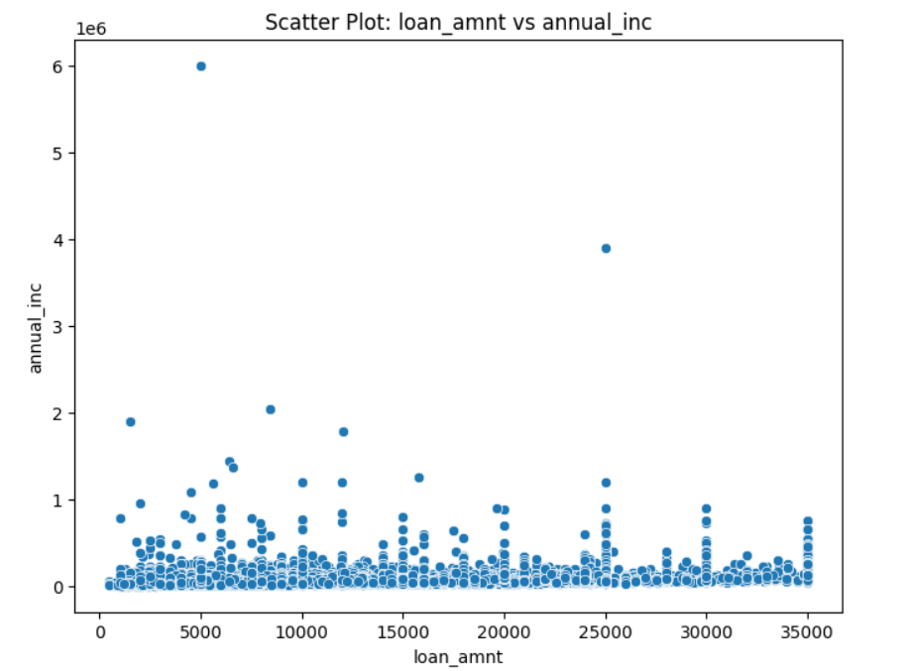
Scatter plot (loan amount vs annual income)
Numerical data comparison between (annual income and loan amount)
Most borrowers have relatively low to moderate annual incomes, primarily below 200,000.
There are a few outliers with significantly higher annual incomes, exceeding 1 million.
Loan amounts range from about 500 to 35,000, but no clear pattern or trend is visible between loan amount and income. Borrowers with both low and high incomes seem to take out loans across the entire loan amount range.
The distribution of the data appears concentrated in the lower income range, with most loans spread out within this band, suggesting income isn't a primary driver of loan size.

Slide 4
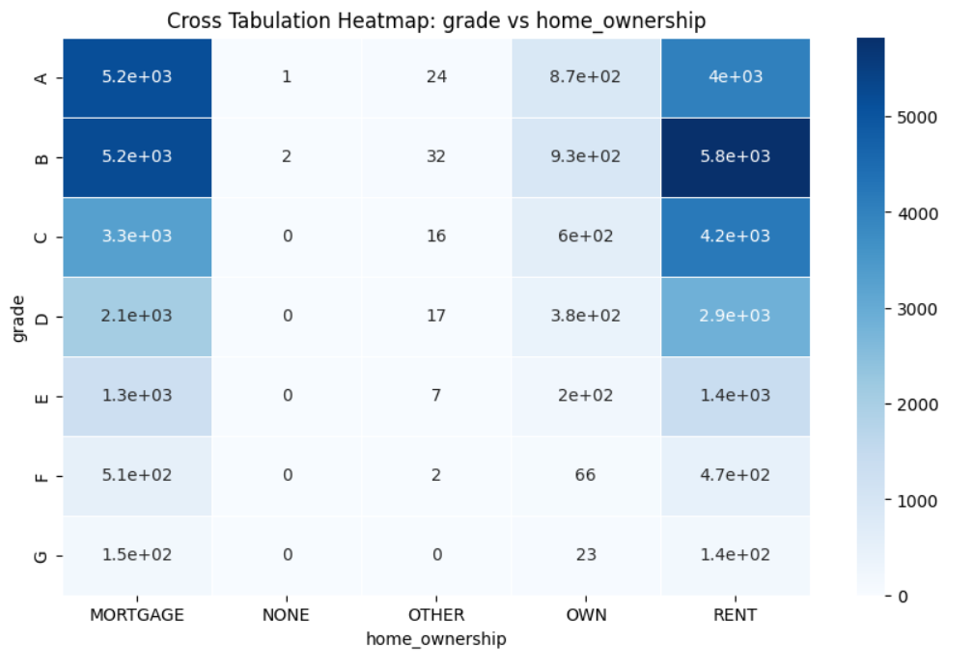
CROSS TABULATION HEATMAP (GRADE vs HOME OWNERSHIP)
Higher loan grades (A and B) are concentrated in the MORTGAGE and RENT categories, suggesting a preference or eligibility for better loan grades among individuals in these home ownership statuses.
As grades descend (C, D, E, etc.), loan counts decrease across all ownership categories.
This suggests a relationship between home ownership status and the likelihood of receiving a higher loan grade, with mortgage holders and renters being more prominent across the board.

Slide 5
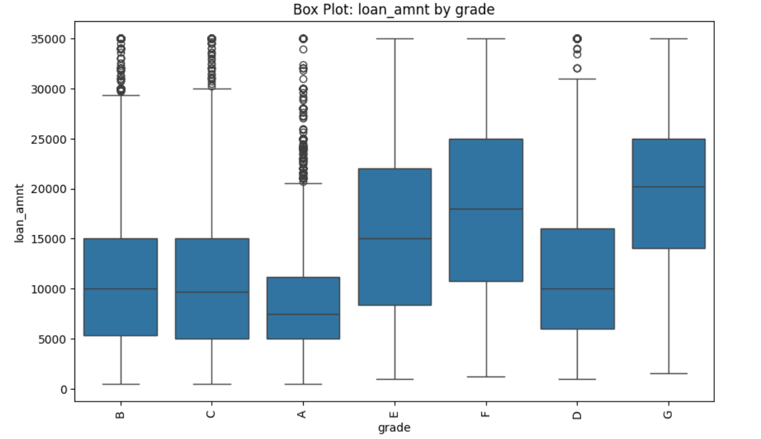
Box Plot (loan amount vs grade)
Distribution: The loan amounts vary considerably across grades, with different medians, interquartile ranges, and outliers for each grade.
Median loan amounts: Grade G appears to have the highest median loan amount, followed by F and E. Grades B, C, and A have lower median loan amounts.
Spread: Grades E, F, and G show larger interquartile ranges (bigger boxes), indicating more variability in loan amounts for these grades.
Outliers: All grades have outliers (represented by circles) above their upper whiskers, with grades B, C, and A having numerous high outliers.
Range: The overall range of loan amounts seems to be from around 0 to 35,000, with most loans falling between 5,000 and 25,000.
Skewness: The data for most grades appears positively skewed, with longer upper whiskers and outliers stretching towards higher loan amounts.
Order: The grades are not presented in alphabetical order on the x-axis, which might indicate a purposeful arrangement based on some other criterion.

Slide 6
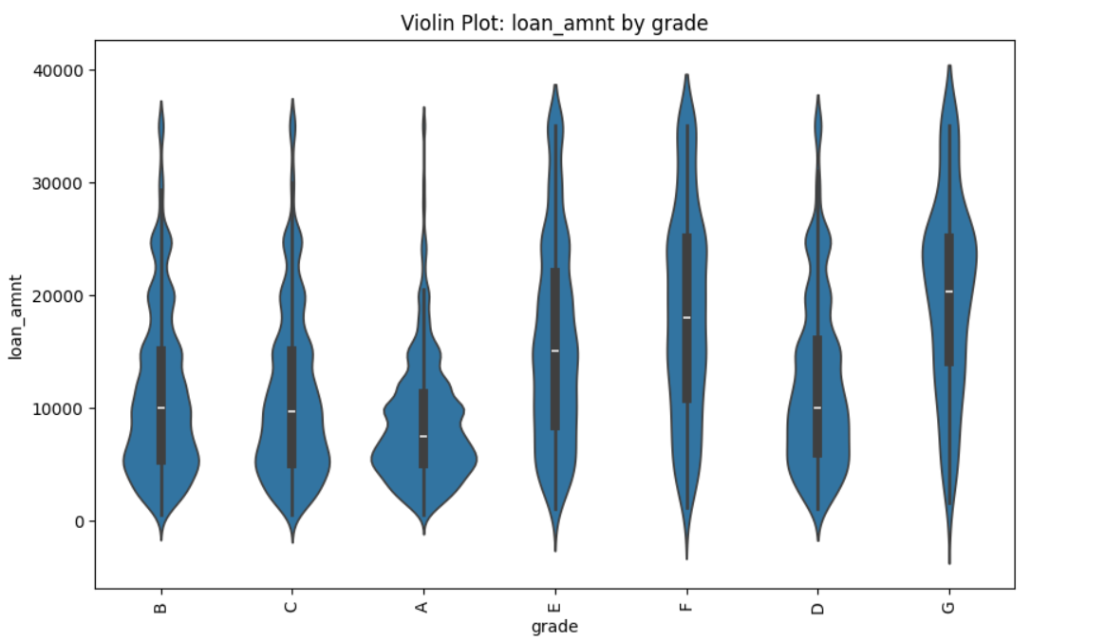
Violin plot (loan amount vs grade)
Distribution shape: The plot displays the distribution of loan amounts for each grade, with wider sections representing a higher probability of observations at that value.
Median and quartiles: Each violin contains a small box plot showing the median (white dot), interquartile range (thick black bar), and whiskers.
Range: Loan amounts generally range from about 0 to 40,000 across all grades.
Grade differences:
  Grades B, C, and A have similar distributions, with most loans concentrated in the lower range.
  Grades E, F, D, and G show more spread and higher median values.
  Grade G has the most distinct distribution, with a higher concentration of larger loan amounts.
Bimodality: Some grades (especially B, C, and A) show bimodal distributions, with two peaks in loan amount frequency.
Skewness: Most distributions are positively skewed, with longer tails toward higher loan amounts.
Density: The width of each violin indicates the density of data points at that loan amount.
Order: The grades are not in alphabetical order, suggesting a purposeful arrangement possibly related to risk or other factors.

Slide 7
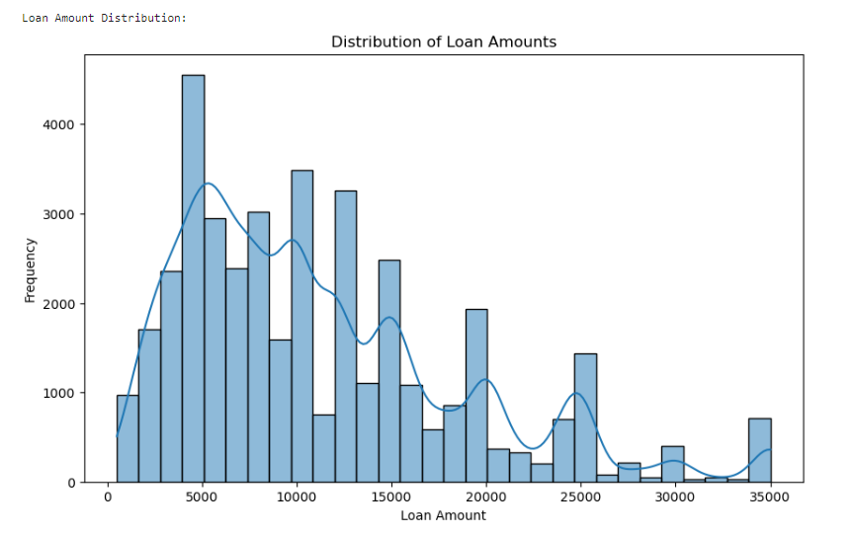
Distribution of Loan amount
Distribution shape: The overall distribution is multimodal, with several peaks.
Range: Loan amounts range from approximately 0 to 35,000.
Main peaks: The most prominent peak occurs around 5,000-6,000, with secondary peaks near 10,000, 15,000, and 20,000.
Frequency: The highest frequency of loans is in the 5,000-6,000 range, with over 4,000 loans in this category.
Skewness: The distribution is positively skewed, with a long tail extending towards higher loan amounts.
Density curve: A blue line represents the kernel density estimation, smoothing out the histogram to show the overall distribution shape.
Intervals: The histogram uses intervals of about 1,000 to group the loan amounts.
Lower frequencies: There are fewer loans at very low amounts (below 2,000) and at higher amounts (above 25,000).
Gaps: There are noticeable drops in frequency between some of the peaks, particularly around 7,500 and 17,500.
Tail: The frequency of loans tapers off gradually for amounts above 25,000, but there's a small uptick at the very end (around 35,000).

Slide 8
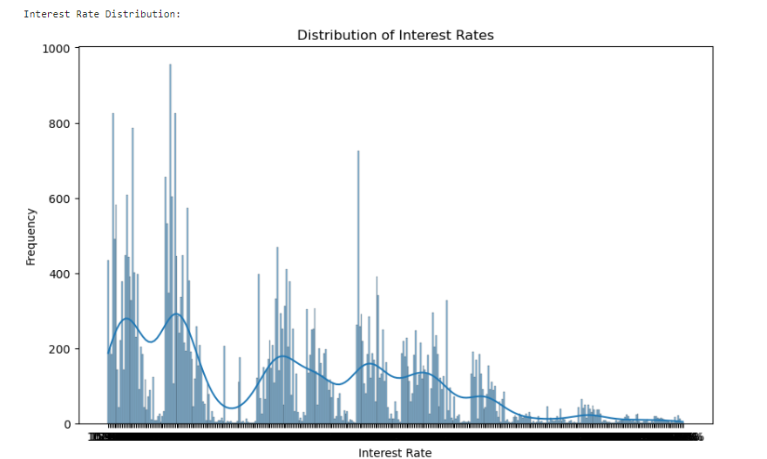
Distribution of Interest rate
Distribution shape: The distribution is multimodal, with several distinct peaks.
Range: Interest rates appear to range from approximately 5% to 30%, based on the x-axis scale.
Peaks: There are multiple prominent peaks, with the highest frequencies occurring in the lower interest rate ranges (around 7-12%).
Frequency: The highest frequency bars reach up to about 950-1000 loans for certain interest rates.
Density curve: A blue line represents the kernel density estimation, smoothing out the histogram to show the overall distribution shape.
Granularity: The histogram uses very fine intervals, resulting in many narrow bars that give a detailed view of rate frequencies.
Skewness: The distribution is positively skewed, with a long tail extending towards higher interest rates.
Clusters: There appear to be clusters of interest rates, possibly reflecting different risk categories or loan products.
Lower frequencies: The frequency of loans decreases notably for interest rates above about 20%.
Gaps: There are some noticeable gaps or drops in frequency between clusters, particularly in the middle range of interest rates.
Tail: The frequency of loans tapers off gradually for higher interest rates, with very few loans at the highest rates (near 30%).

Slide 9
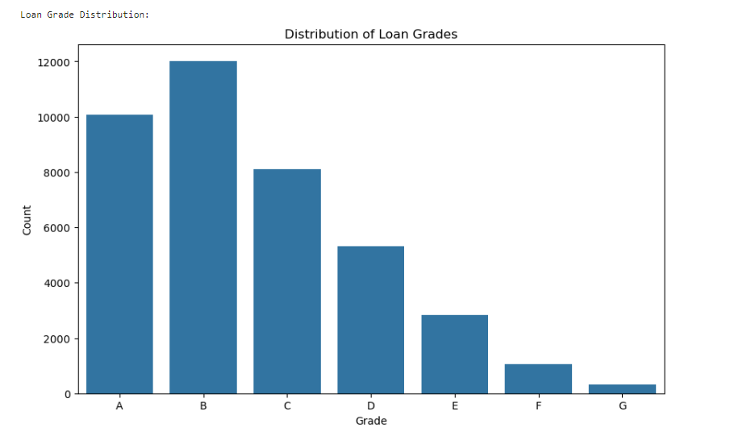
Distribution of GRADE
Loan grades: The chart displays seven loan grades, labeled from A to G.
Frequency: The y-axis represents the count of loans for each grade, ranging from 0 to 12,000.
Distribution shape: The distribution is not uniform, showing a clear pattern across grades.
Most common grade: Grade B has the highest frequency, with over 12,000 loans.
Second most common: Grade A is the next most frequent, with about 10,000 loans.
Decreasing trend: There's a general decreasing trend in loan frequency from grade B to G.
Least common: Grade G has the lowest frequency, with fewer than 1,000 loans.
Middle grades: Grades C and D have moderate frequencies, with C having around 8,000 loans and D about 5,000.
Lower grades: Grades E, F, and G show a continued decrease in frequency, with E having about 3,000 loans, F around 1,000, and G the fewest.
Skewness: The distribution is skewed towards the higher grades (A and B), indicating a preference or higher qualification for these grades in the lending system.

Slide 10
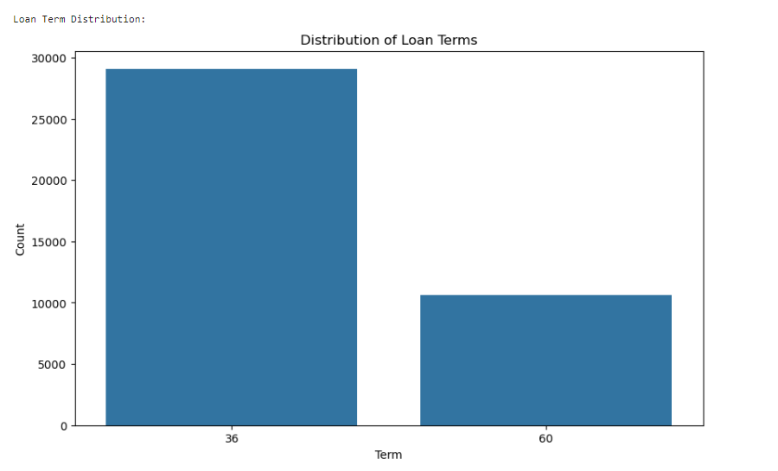
Distribution of loan term
The graph projects the data of loan term of repayment taken by borrowers.
The maximum borrowers prefer to take loan for 36 month term from all categories.
Borrowers with lower loan amount 500 – 10000 prefer to go for 60 month term as well.

Slide 11
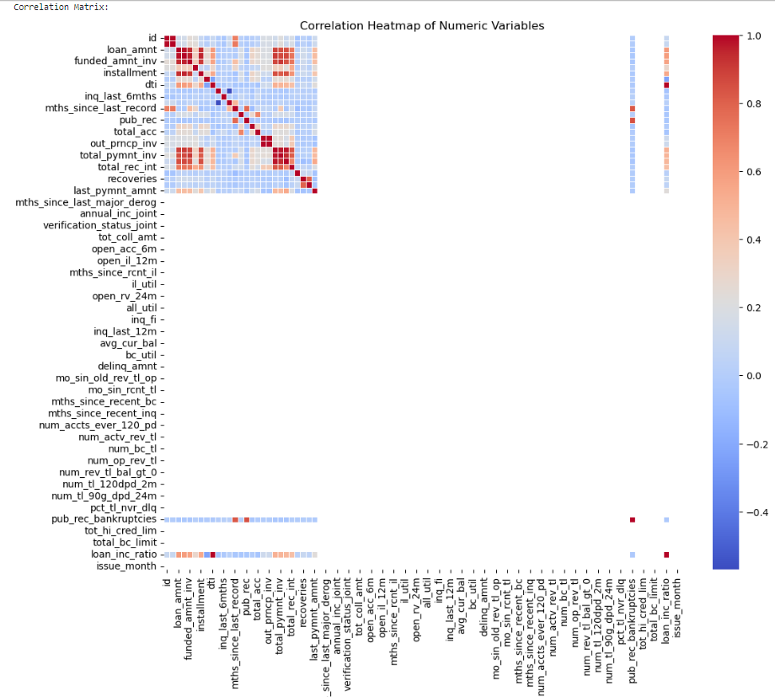
Correlation heatmap of numerical variables
correlation heatmap of numeric variables, showing the correlation coefficients between different variables in a dataset. Each cell in the grid represents the correlation between two variables, with colors ranging from blue (negative correlation) to red (positive correlation).
The variables include terms like “loan_amnt,” “funded_amnt,” “installment,” and others, suggesting that this heatmap is related to financial or loan data.
Loan Amount (loan_amnt) and Funded Amount (funded_amnt): These two variables are typically highly correlated because the funded amount is often very close to the loan amount requested.
Installment and Loan Amount (loan_amnt): The installment amount is usually directly related to the loan amount, with larger loans having higher installments.
Total Payment (total_pymnt) and Total Received Interest (total_rec_int): These variables are often strongly correlated as the total payment includes the principal and the interest received.

Slide 12
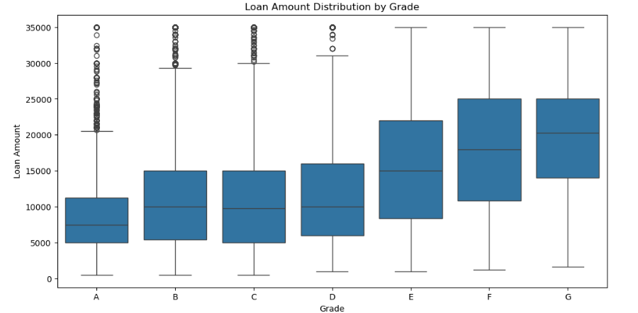
Loan amount distribution by grade
Grade A: Has a relatively narrow IQR, indicating less variability in loan amounts. The median is lower compared to other grades.
Grade B: Shows a wider IQR, suggesting more variability. The median is higher than Grade A.
Grade C to G: These grades generally show increasing medians and wider IQRs, indicating higher loan amounts and more variability as the grade decreases.
Central Tendency: The median loan amount increases from Grade A to Grade G.
Dispersion: The variability in loan amounts (IQR) also increases from Grade A to Grade G.
Outliers: There are more outliers in the lower grades (E, F, G), indicating some exceptionally high or low loan amounts.

